Slide 1
Nutrition Counseling Strategies

Slide 2
Review and Warm-up Activity
Practice review of addressing a myth.
What are the recommended steps to providing advice?
What are the 4 stages of motivational interviewing and a counseling session in general?

Slide 3

Objective: Practice Evidence-Based Strategies in Nutrition Counseling
Self Monitoring
Personalized Structured Meal Plans
Motivational Interviewing
Problem Solving
Collaborative Goal Setting
Cognitive Restructuring
Stimulus Control

Slide 4

Self-Monitoring
What are some examples of things to self-monitor?
What are the potential benefits?
What are the potential drawbacks?

Slide 5
Self-Monitoring
Use it to support autonomous self monitoring, identify patterns, triggers, affirms successes, and to assist with problem solving and goal setting
In the beginning, provide strong rationale, resources, and instructions for self-monitoring (Their idea and a WOOP recommended)
The amount of feedback required, typically diminishes as patient/client skill improves

Slide 6
Scrip for Counseling Someone about keeping a Food Record
Client: Of all the things we’ve talked about trying, I like the idea of using my fit bit to track my foods is the best idea.
RDN: Remind me why you think this is important to try.
Client: I know I will think twice about snacking if I have to record it and I know I need to get on to a better routine.
RDN: Keeping a food record for a week will help you toward getting a more organized eating routine going. Any other reasons you think this is important?
Client: I really do know what to do and I’m not doing it. This will help with figuring out why I don’t you know?
RDN: It might help you discover some of the psychological things that might be going on.
Client: Yes.
RDN: May a make a recommendation?
Client: Of course.

Slide 7
Continue Scrip for Counseling Someone about keeping a Food Record
RDN: Is their room in the app to also record what your thinking and feeling when, say, you eat well and when you eat less well?
Client: Let’s see. Yes…looks like you can. That’s a good idea. I’ll do that too.
RDN: You have strong reasons and a plan. (pause) On a scale from on to 10…10 being totally confident about being able to do this and zero being not at all confident…how confident are you that you’ll be able to record all food intake and also make notes both when things go well and when things don’t go well.
Client: About a 7.
RDN: Tell me why a 7 instead of a 10.
Client: It will be pain and I won’t want to record things especially on the weekends.
RDN: Nodding looking interested.
Client: On the weekends I tend to drink a lot of wine and I won’t want to record that plus my days will be less structured.

Slide 8
Continue Scrip for Counseling Someone about keeping a Food Record
RDN: Do you think it’s important to record what happens on weekends?
Client: Yes. Definitely. That’s where the problems are.
RDN: You really know yourself. (pause and mean it) What ideas do you have for overcoming this problem?
Client: I don’t really know--Maybe I could set an alarm on my phone for when I will do it and ask my girl friend to do it with me.
RDN: Those sound like good ideas. When would you ask her and when would you do it together?
Client: I could ask her tonight and we could do it right before we start making dinner on Friday and Saturday.
RDN: I like how you nailed this down to a specific time. It’s and “if” “then”-type plan, If it’s time to make dinner, then we will record what we’ve eaten so far and also anything thoughts we had about when we ate so far. Do I have that right?
Client: Yes. It’s ambitious but I think I can do it and she will do it.
RDN: I’ll send you a summary of your plan and next week you’ll let me know how it went. Even if it doesn’t work, at least we will have learned something.

Slide 9
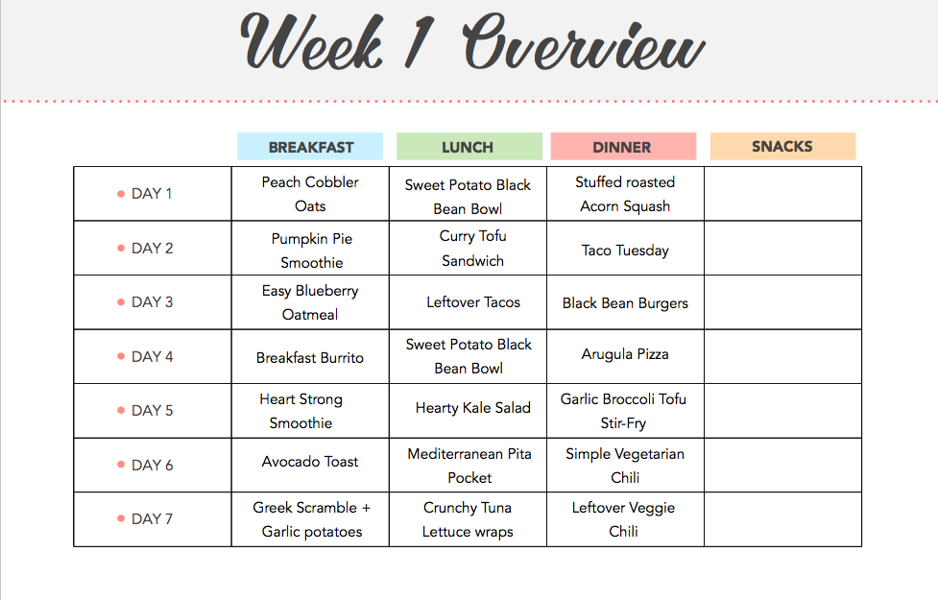
Structured Meal Plans & Meal Replacements
What are some examples of meal plans and replacements?
What types of clients might benefit?
What are the drawback of structured meal plans and meal replacements?

Slide 10
Structured Meal Plans & Meal Replacements
Provide in response to client’s need for and interest in
Provide rationale and describe how it’s developed
Collaboratively develop
Collaboratively anticipate challenges, ideas for overcoming, and ideas for getting back on track
Agree on indicators: the is plan working; the plan isn’t working; what to do if the plan isn’t working; and follow-up.

Slide 11
Structured Meal Planning Resources
Interactive DRI for Healthcare professionals
http://fnic.nal.usda.gov/fnic/interactiveDRI/
Choose My Plate to find exchange menu plans.
http://www.choosemyplate.gov/tools-daily-food-plans
Serving sizes for the exchanges.
https://www.nhlbi.nih.gov/health/educational/lose_wt/eat/fd_exch.htm
To run a diet analysis use the Canadian government site.
https://www.eatracker.ca/

Slide 12
Practice Collaboratively Developing a Menu Plan
Client: I think having a structured meal plan to go by will help me get started on a consistent carb diet.
RDN: You are really determined to beat diabetes.
Client: Yes.
RDN: To help me develop this, it would be helpful for me to know what is typical for you. That way I can come-up with something that is responsive to your routines and culture. Can you take me through a typical day or eating and drinking?
Client: bla bla bla
RDN: to summarize, your first meal is at about 10 am. You typically have…bla bla bla. Pause. What modifications to that patterns would you like me to make?
Continue using your brilliance.

Slide 13

Problem Solving

Slide 14
Problem Solving
Work collaboratively with client to:
Define the problem (consider shame and use competent language)
Brainstorm solutions
Weigh pros/cons of potential solutions
Select/implement strategy
Evaluate outcomes
Adjust strategy

Slide 15
Competent Language
Over weight instead of obesity. Severely overweight instead of morbid obesity.
Nutrition rehabilitation instead of counseling
Energy instead of carbohydrates
Fuel instead of calories
“With nutrients, the body has amazing abilities to heal and get back on track.”
“Nutrition rehabilitation can take 1-2 difficult years. Unfortunately, the brain is usually the last thing to respond to nutrition rehabilitation. We can’t go part way with this. I’m thinking of meeting weekly for a month or so and then monthly for at least 6 months. What do you think?”

Slide 16
Practice Helping a Client Problem-Solve
Failure to thrive child.

Slide 17
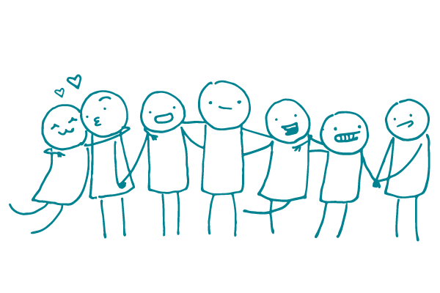
Supporting Social Support

Slide 18
Supporting Social Support
Establish a collaborative relationship
Assist client to identify family/community support
Provide role-play and resources to help clients further their social skills (assertiveness, making new friends, conflict resolution…)
Conduct education in group and support participants’ connection/sense of community
Encourage family involvement

Slide 19
Practice Coaching a Client to Elicit More Social Support
RDN: what are your ideas for getting the social support you need?
Client: I really want my family to help me out. That would make all the difference.
RDN: You know that the social support really makes a difference for you. (Pause). But it’s not that easy. Even people who want to help don’t always know how to.
Client: That’s true.
RDN: What would you say are the most helpful things people can do that would help you?
Client: I guess I need my family to build this up and not make fun of me.
RDN nodding. Totally makes sense. What does that look like?
Client: They would be more like you (laughing) they would notice when I try and they would be accepting when I failed.
RDN: A few words of encouragement and some empathy would go a long way.
Client: Yes.
RDN: I have a hand-out summary of how to do that and there is even a book on emotional intelligence. Do you think your family would read the hand-out?

Slide 20
Practice Coaching a Client to Elicit More Social Support
Client: They would read the hand-out.
RDN: I have another idea too. Okay to share it?
Client: sure.
RDN: What if you became super at helping your family with their goals…you could be a role model for them.
Client: I would need to know their goals. I don’t know whether my son has any. Laughs.
RDN nodding: You would need to know their goals. You would need to be the family leader on getting better at supporting each other.
Client: Makes sense. Does your handout teach me that?
RDN: It gives ideas. If you’re serous about creating a more supportive family environment, and I think it’s a brilliant idea, you probably need coaching by someone who specializes in this—like a family counselor.
Client: You know, I think it might be worth it to do that.
RDN: Honestly, I think all families need that and you’re smart to actually act on the idea.

Slide 21
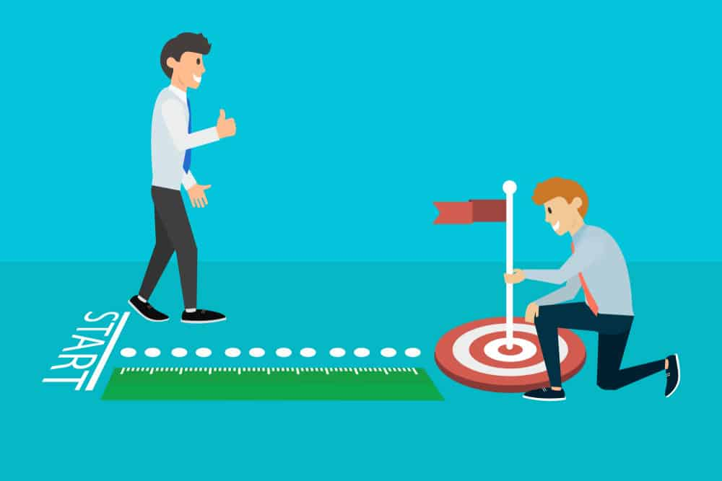
Goal Setting/Experiments

Slide 22
Goal Setting/Experiments
Coach client on goal setting skills
Provide tracking resources
Probe pros and cons, importance and confidence of proposed goals
Assist with planning
Encourage realistic steps and building supportive environments
Encourage curious mindset (rather than punitive) by affirming intended and unintended outcomes

Slide 23
Your sedentary friend asks you to help them set a goal for becoming more active
Practice collaborative goal setting.

Slide 24

Stress Management
Reaction to stress may cause some clients to lose their appetite and others to overeat.
The focus is on changing the environment or clients’ responses to the environment.

Slide 25
Stress Management
Environmental focused strategies may include:
Guidance on planning ahead for eating and exercise
Use of time management skills
Developing a support system
Building skills to prepare quick and healthful “go-to” meals and snacks
Guidance for eating out

Slide 26
Stress Management continued
Emotion -focused strategies may include:
Use of positive self-talk
Building assertiveness in expressing eating desires
Setting realistic goals
Learning to deal appropriately with emotion-driven eating cravings
Relaxation exercises

Slide 27
Practice Coaching a Client on Non-Food Stress Coping

Slide 28
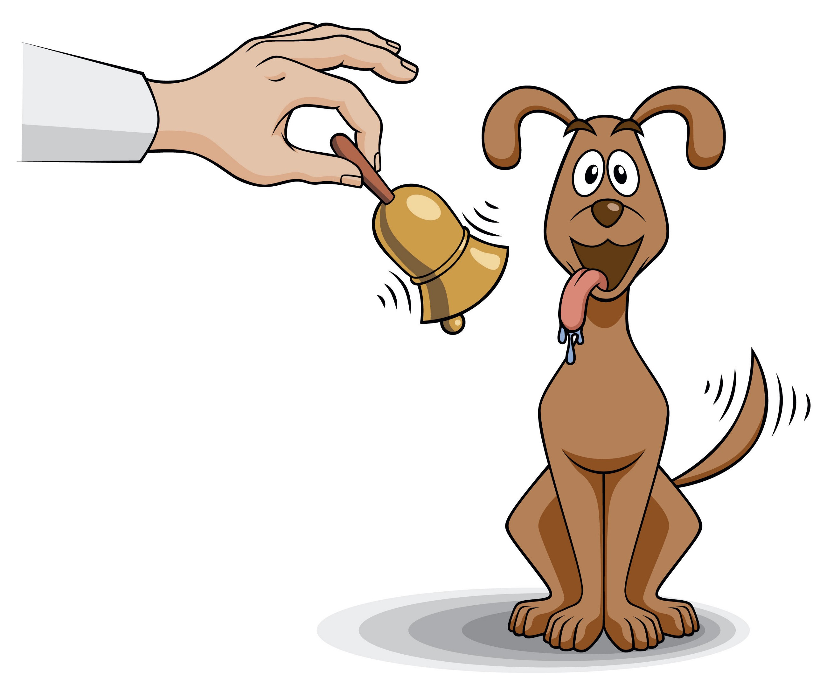
Stimulus Control

Slide 29
Stimulus Control
Identifying and modifying social or environmental triggers for undesirable diet and physical activity behaviors
Reviewing self-monitoring records with clients may help identify triggers
Support client to identify ways to modify the environment or their response to the environment

Slide 30
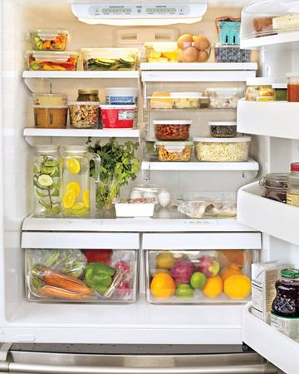
Advise a Client on Stimulus Control

Slide 31
Other Strategies Used in the DPP
Lifestyle activity
Time management training
Relapse prevention and coping
Food substitutions or Volumetrics
Label reading
Target heart rate

Slide 32
